Slide 1
LIBERTAS INTERNATIONAL UNIVERSITY

Slide 2
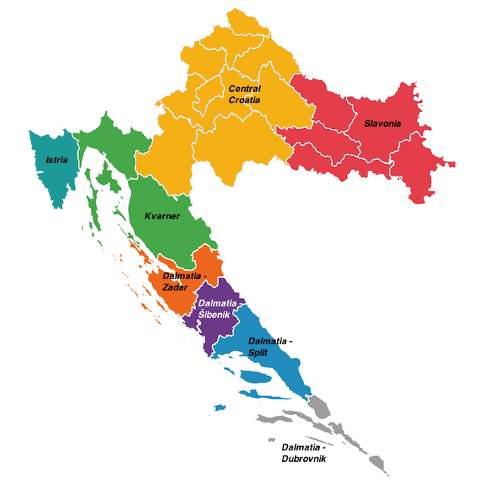
WELCOME TO LIBERTAS
Zagreb
Kutina
Dubrovnik

Slide 3
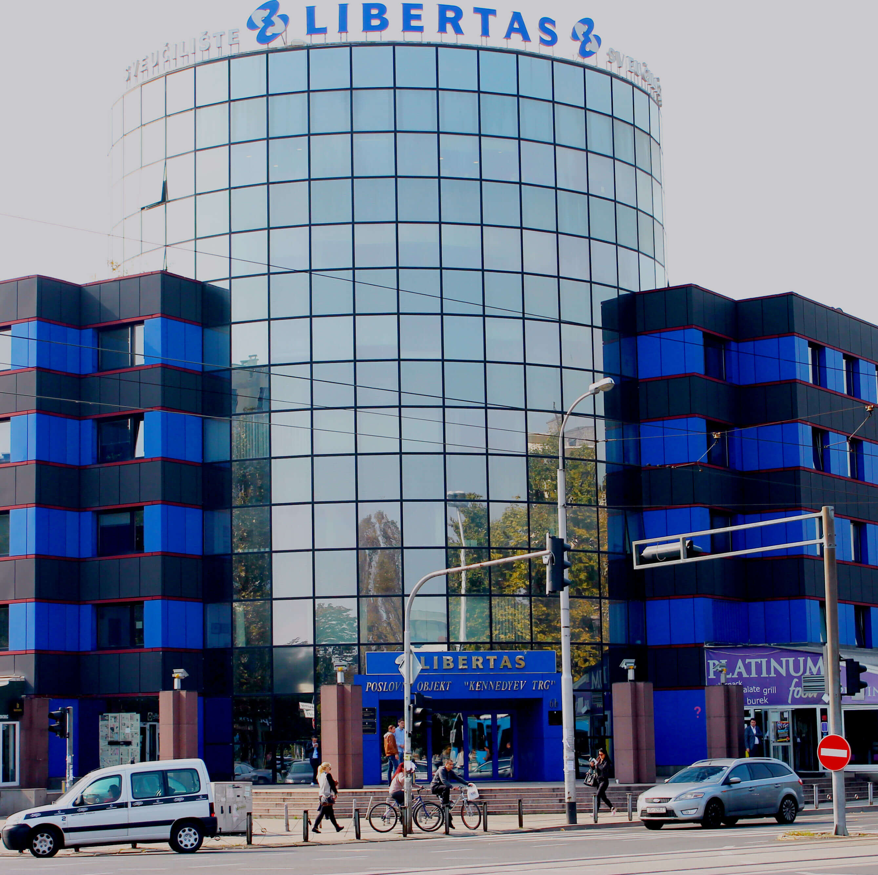
UNDERGRADUATE UNIVERSITY PROGRAMS
International Relations and Diplomacy
International Business
Physical Therapy
Acting

Slide 4
UNDERGRADUATE PROFESSIONAL PROGRAMS
Business Economics
Tourism and Hotel Management
Business Security Management
Sports Management

Slide 5
GRADUATE UNIVERSITY PROGRAMS (MASTERS)
Business Economics and Globalisation
Internatonal Relations and Diplomacy

Slide 6
GRADUATE PROFESSIONAL PROGRAMS (MASTERS)
Domestic and International Trade
Banking, Insurance and Financial Management
Tourism and Hotel Management

Slide 7
POSTGRADUATE STUDY PROGRAMS
International Relations (doctoral)
Quality Management in Healthcare (postgraduate specialist study program)

Slide 8
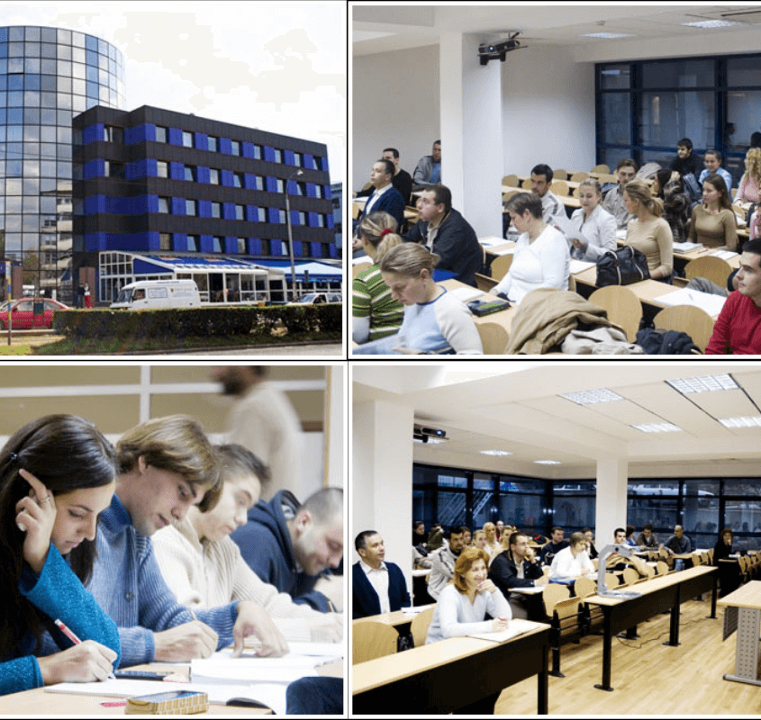
OFFICES
Careers center
Student Registration office
International Relations Office

Slide 9
ERASMUS+ PROGRAM
42 partners
Student mobility, erasmus internships, staff mobility, professor mobility

Slide 10
GOALS
Encouraging the mobility of students, teachers and administrative staff,
Srengthening cooperation between higher education institutions in Europe,
Increasing the level of transparency and compatibility of qualifications in higher education.

Slide 11
ZAGREB

Slide 12
DUBROVNIK

Slide 13
Students get the chance to perform varouis tasks in:
Ministries and foreign affairs
International departments
Export companies
International organisations
Governmental bodies
Chambers of commerce

Slide 14
Thank you!
Martina Glavan

