Slide 1







CÁ
DI
Z
U
C
A

Slide 2
CÁ
DI
Z
U
C
A

Slide 3
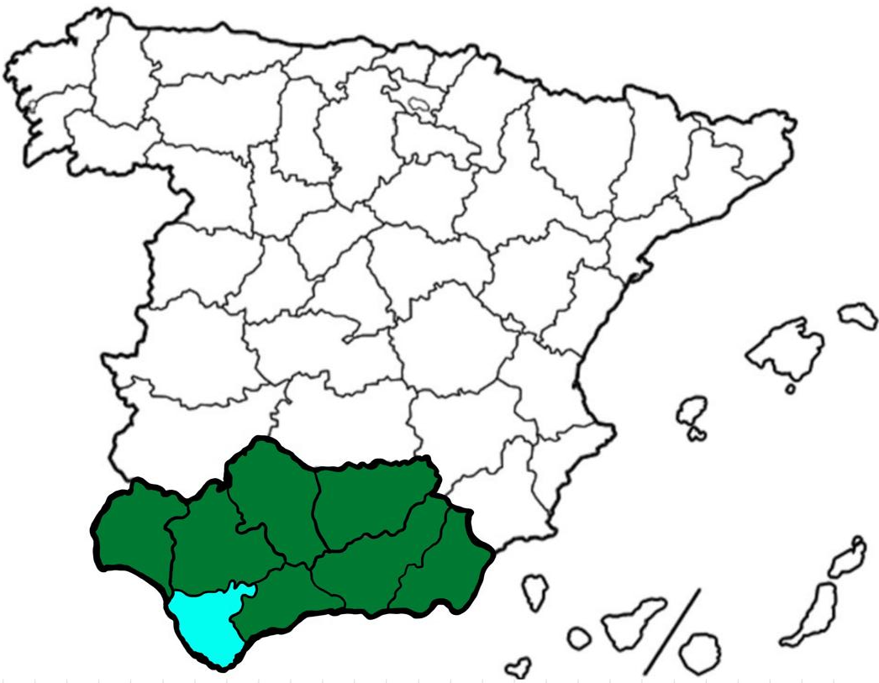
We thank you for your interest in studying at the
University of Cádiz
Here begins your personal and professional formation
Cádiz
Andalusia

Slide 4



Slide 5


01
Regular Students

Slide 6

University studies
Pre-university studies
University studies undertaken abroad
University studies completed abroad.

Slide 7
Applicable education system
Please select the type of education system that supports your pre-university studies.
EU or Convention countries
Other education systems

Slide 8

Educational System pertaining to the EU or with Convention
Click here if your education system belongs to the EU or any academic system in Switzerland, Noriega, Liechtenstein, Principality of Andorra, China or Colombia.

Slide 9
Other education systems
Without entrance examination to the University (Foreigners phase)
With entrance examination to the University (Ordinary and Extraordinary phase)

Slide 10

Without examination process (Foreigners phase)
ATTENTION: You are not eligible for degrees in Health Sciences or Education.
**You must comply the next requisites (link).
More information here.

Slide 11

02
University of Cádiz

Slide 12
Mobility programs
Erasmus+ KA131
Erasmus+ KA171
EU Universities + Noriega, Switzerland, Serbia, Northern Macedonia, Liechtenstein, Turkey, United Kingdom e Ireland.
Confirm that your home university is part of the list of Partner Universities of the current Call.
Annex I.
FactSheet
Visitants y Freemover Students
General information
Internationalisation Office
International Mobility Coordinators
Students whose mobility it’s not funded by the European Commission.

Slide 13

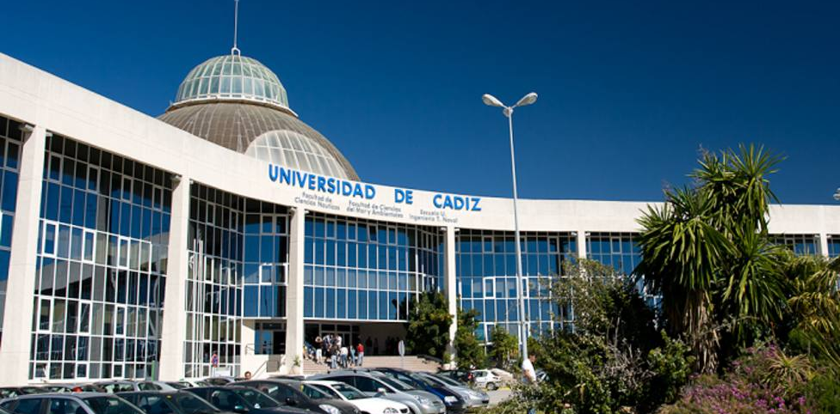
Erasmus+ KA131
For being able to study at the University of Cádiz as an Erasmus+ during one semester or the whole academic year, first you must ask your Home University for your nomination.
Link to website.

Slide 14


Erasmus+ KA171
For studying at the University of Cádiz as an Erasmus+ during one semester or the whole academic year, you must ask your Home University to nominate you according to the University of Cádiz Call. (Annex I - VII)
Link to website.

Slide 15


Visitant and Free-mover Students
For studying at the University of Cádiz wihout Erasmus+ funds through a Convention (Visitant Student) or without convention (Free-mover), please find at the link relevant information regarding your mobility (prices, signatures, etc).
Link to website.

Slide 16

03
UCA Information

Slide 17
Oficial sites
Campus Information
Services Información
Website.
Instagram.
Facebook.
Twitter.
Cádiz, Jerez, Puerto Real and Bay of Algeciras (See)
Click here to know more.

Slide 18
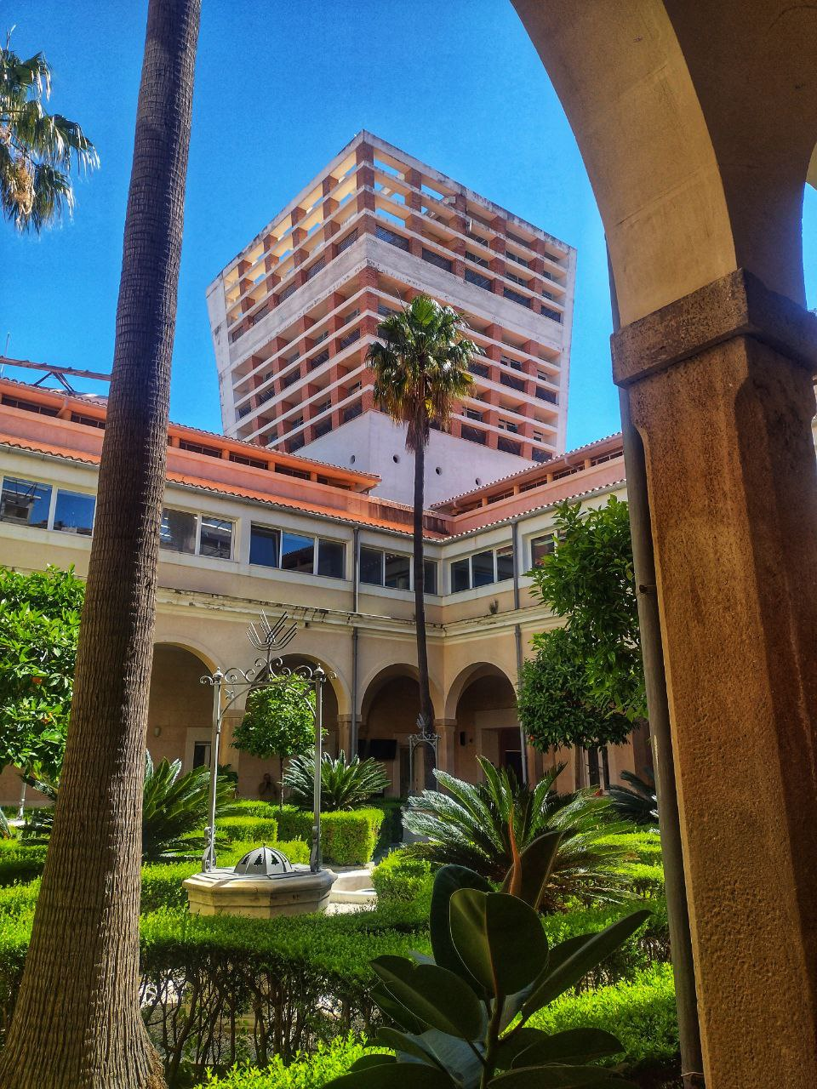
3.2
Campus of the UCA

Slide 19
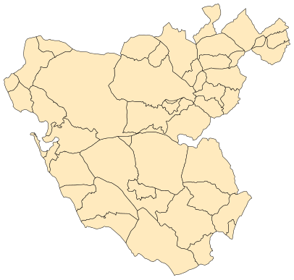


University Campuses
Get to know them!
Campus Cádiz
Campus Puerto Real
Campus Jerez
Campus Bay of Algeciras

Slide 20



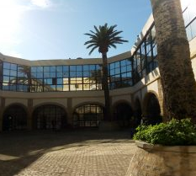
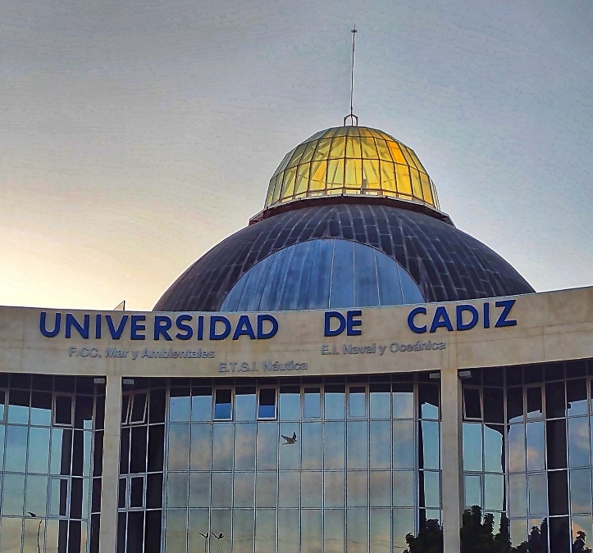
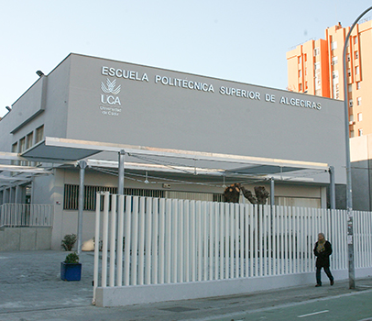
CAMPUS CADIZ
The Campuses of the University of Cádiz are in the Province of Cádiz.
Please click on the Campus you are going to study to know more about your Faculty, academic offer, timetables, etc.
CAMPUS JEREZ
More information (here)
CAMPUS PUERTO REAL
CAMPUS BAY OF ALGECIRAS

Slide 21






Faculty of Medicine
Faculty of Arts
Fac. of Laboral Sciences
Fac. of Business
Faculty of Nursing and Physiotherapy
CAMPUS CADIZ
University Centre for Nursing “Salus Informorum”
More information (aquí)

Slide 22



Faculty of Law
(Link)
Fac. of Social and Communication Sciences
(Link)
CAMPUS JEREZ
More information (here)

Slide 23







Faculty of Sciences
Faculty of Marine and Environmental Sciences
University School of Engineering
University School of Naval and Oceanic Engineering
University School of Marine Nautical and Radio electronical Engineering
CAMPUS PUERTO
REAL
Faculty of Educational Sciences
More information (here)

Slide 24



Escuela Técnica Superior de Ingeniería
(Link)
Faculty of Nursing
(Link)
University School of Education Virgen de Europa
CAMPUS BAHÍA DE ALGECIRAS
(Link)
More information (here)

Slide 25




Thank you
For being interested in selecting the University of Cádiz as your destination.
www.uca.es

