Slide 1
UNIVERSITY OF CÁDIZ
UNIVERSITY OF OSIJEK Josip Juraj Strossmayer University of
Osijek
&

Slide 2
Welcome everyone! ¡Bienvenidos, colegas de España!
I’m honored to be presenting this at the Erasmus International Staff Week in Cadiz, Spain, and hope to inspire you to consider future collaborations with our university.
I’m going to share with you how Erasmus+ mobilities in general and at our university can be an incredibly rewarding experience, both academically and personally. Throughout this presentation, you’ll learn a bit about our university, the vibrant city of Osijek, and some of the ways staff mobility can enhance professional growth and international collaboration.

Slide 3
WHERE IS OSIJEK, ANYWAY?

Slide 4
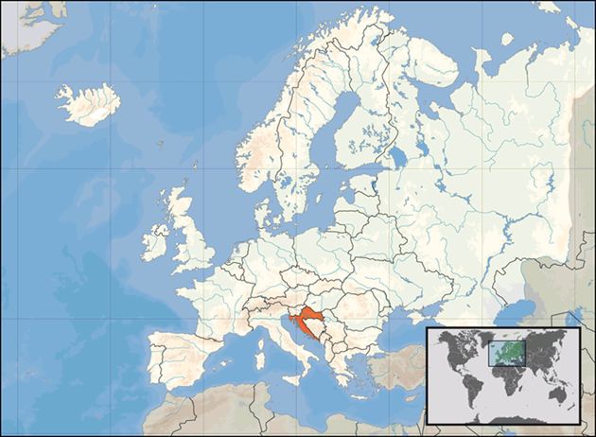
And here’s Osijek, all the way in the east of Croatia.
This little orange thing is Croatia. We’re located in Southeastern Europe.
And this is you. So close. ☺

Slide 5
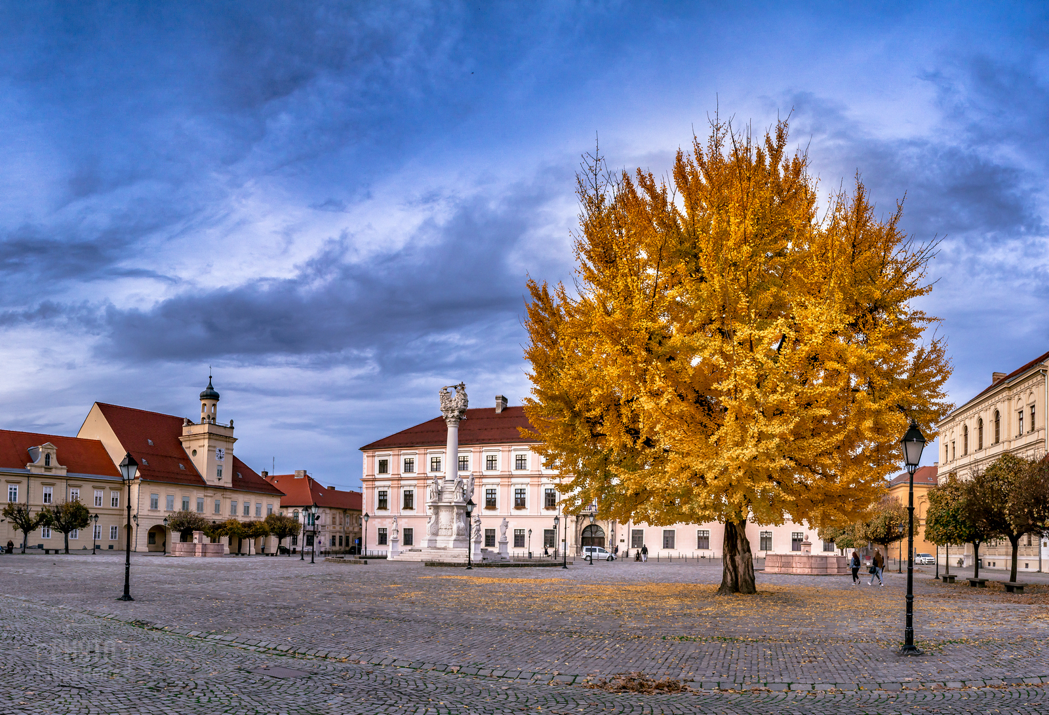
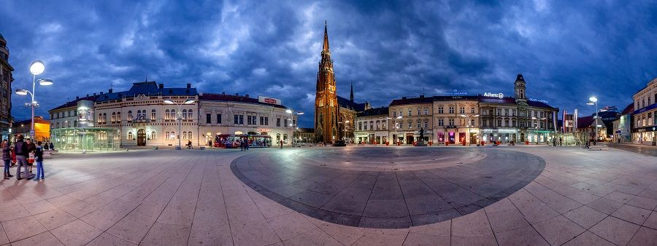
OSIJEK: MAIN INFO
Cultural, administrative and economic center of Eastern Croatia
City area: 171 square km
Population: 96,313
4th largest city in Croatia
River Drava

Slide 6
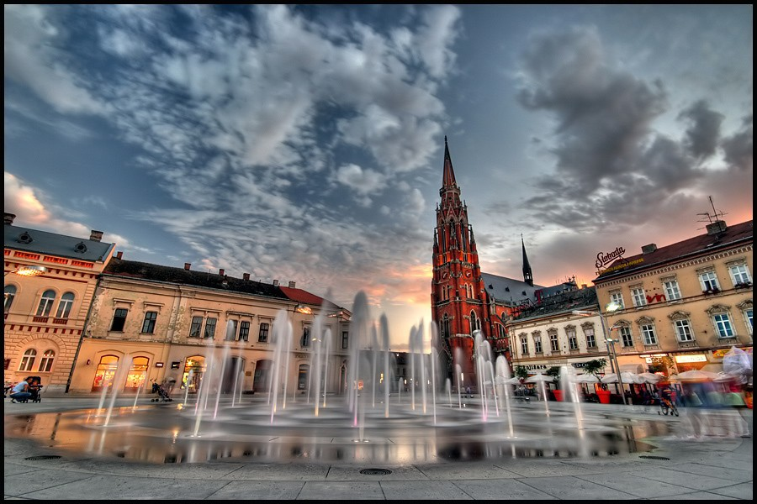
OSIJEK: THE CITY OF CULTURE AND HISTORY
Osijek, located in Eastern Croatia, is the greenest city in Croatia with 17 beautiful city parks. It is not only a hub of culture and history but also a city that offers a warm and welcoming environment for international visitors.

Slide 7
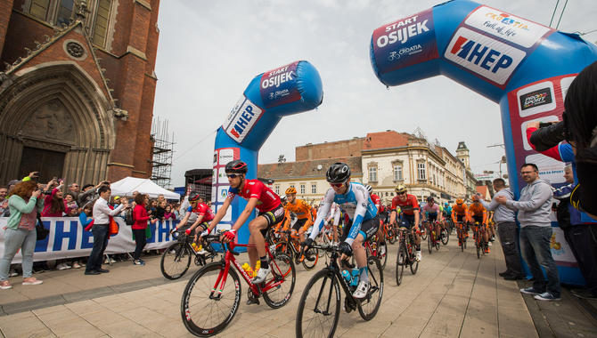
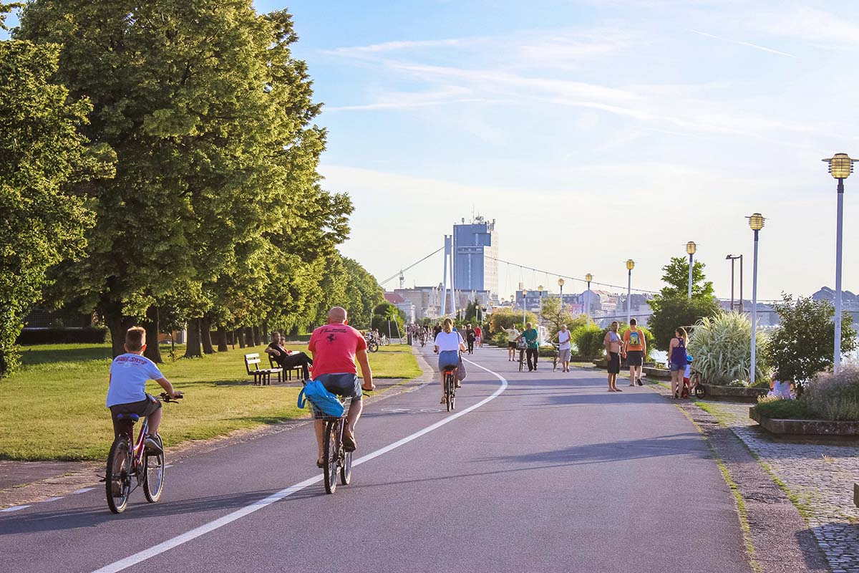
OSIJEK: FUN FACTS
Osijek – The cycling city of Croatia
With more than 40 kilometers of cycling paths and the construction of new ones, the citizens of Osijek have recognized the value and need for bike lanes, as well as a healthy alternative to cars for their own health and recreation.
Osijek is the city with the most cycling paths in Croatia, and they will take you to almost all parts of our lovely city.
Osijek is also located on several international cycling routes like the European cycle route network EuroVelo 6 that connects Atlantic with the Black Sea, the Danube cycling route and the Pannonian Peace Trail.

Slide 8
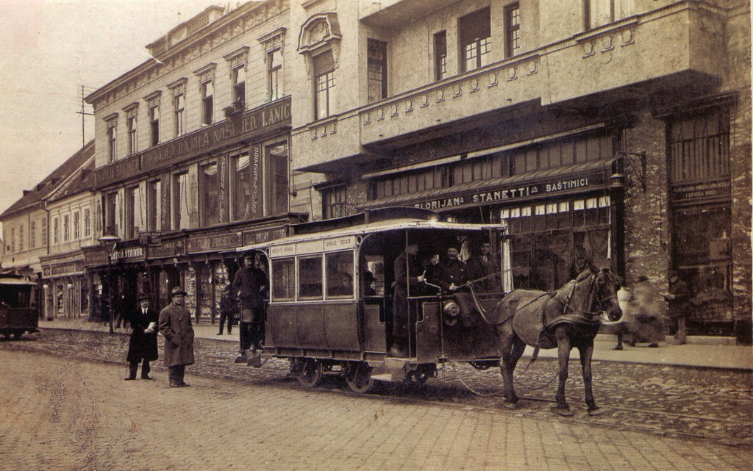
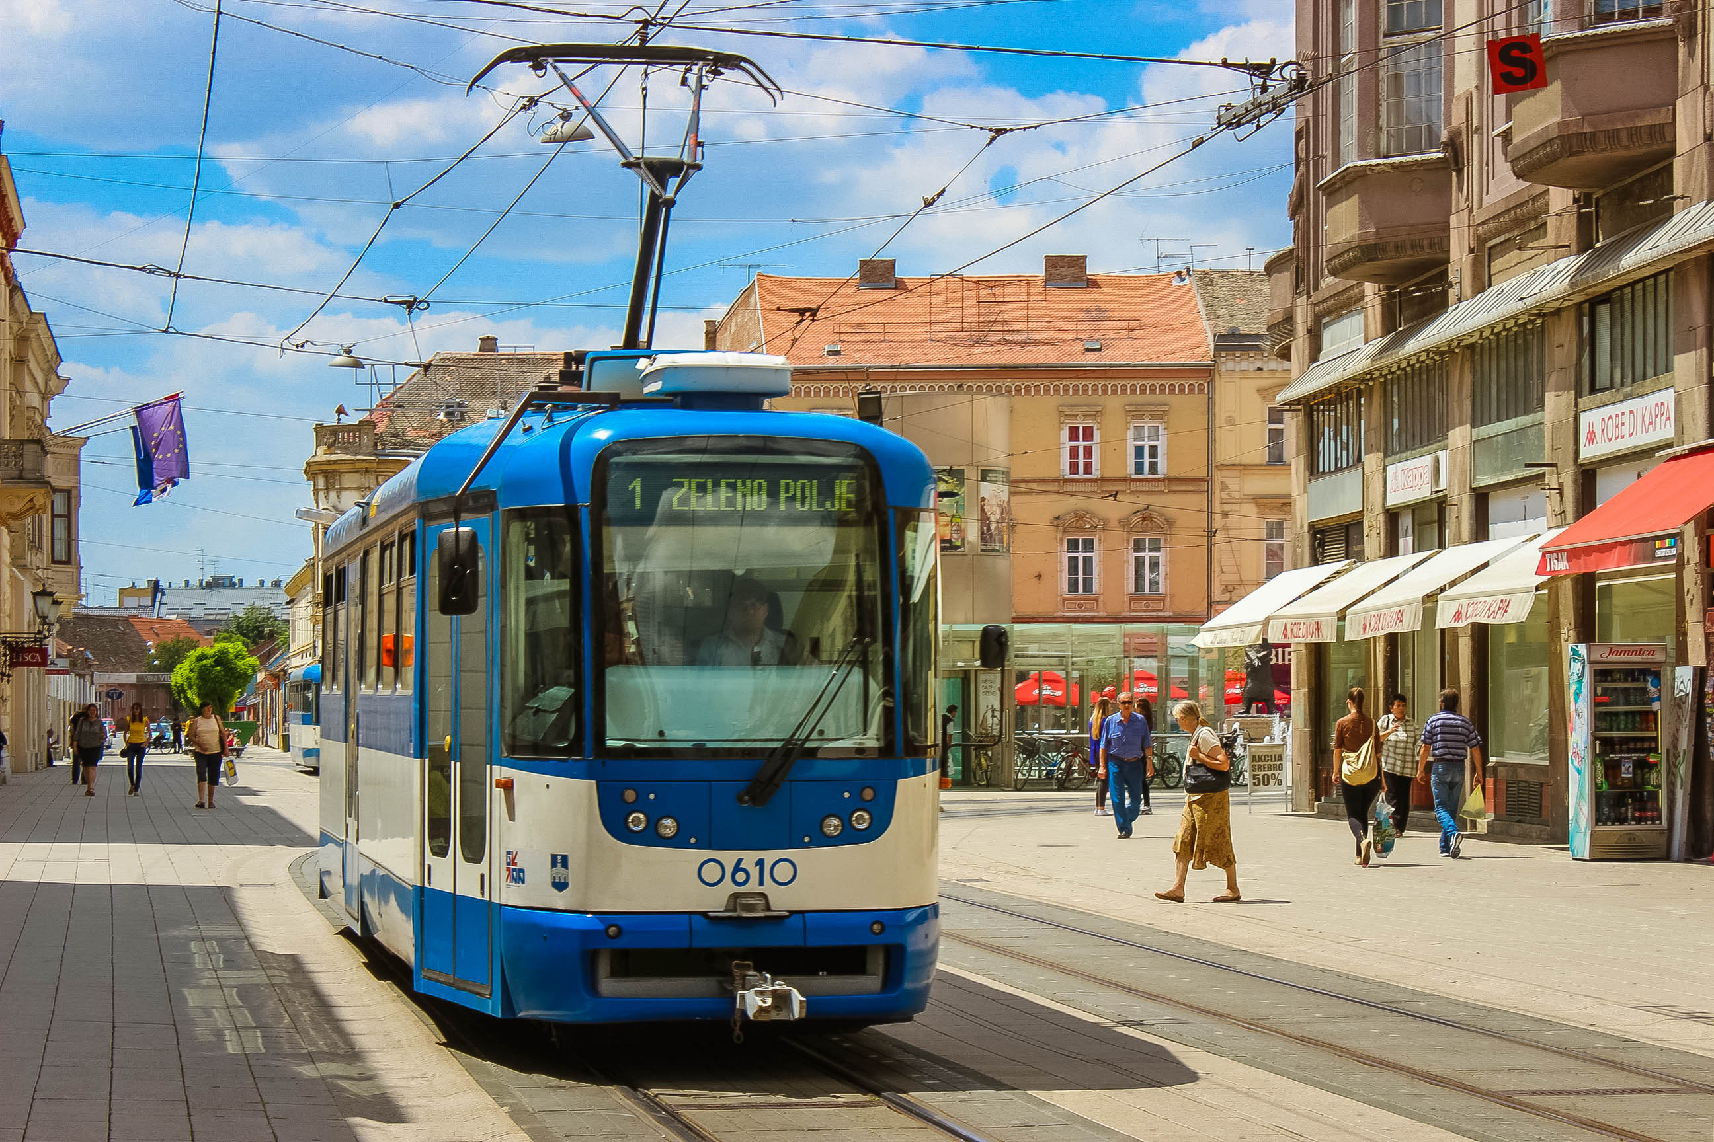
The first tram in Croatia
The first tram in Croatia started in Osijek in 1884.
Osijek was the first city in Croatia and this part of Central Europe to have modern urban transport. A horse-drawn tram started to operate on September 10th 1884 at the time when Osijek had some 18,000 inhabitants along a 10 km route from west to east.

Slide 9
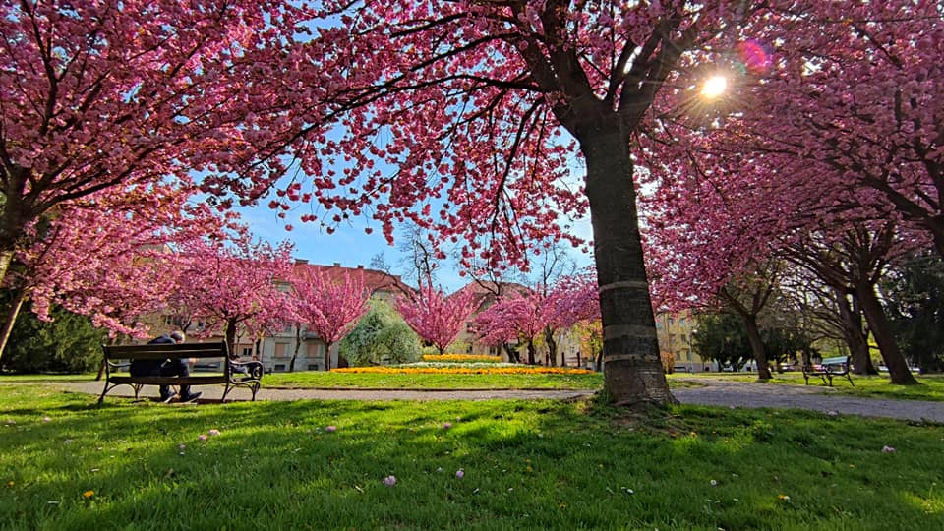
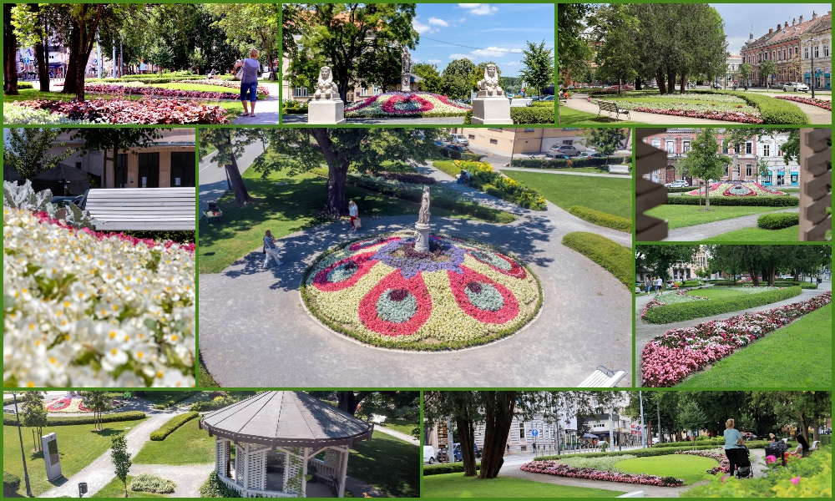
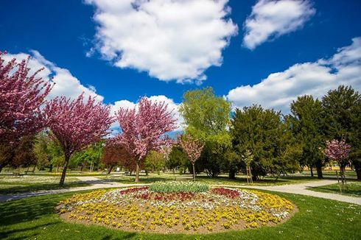
The greenest city – The city of parks
Osijek has 17 parks that have won the city of Osijek many awards over the years. It is the only city in Croatia that has more parks than squares.

Slide 10
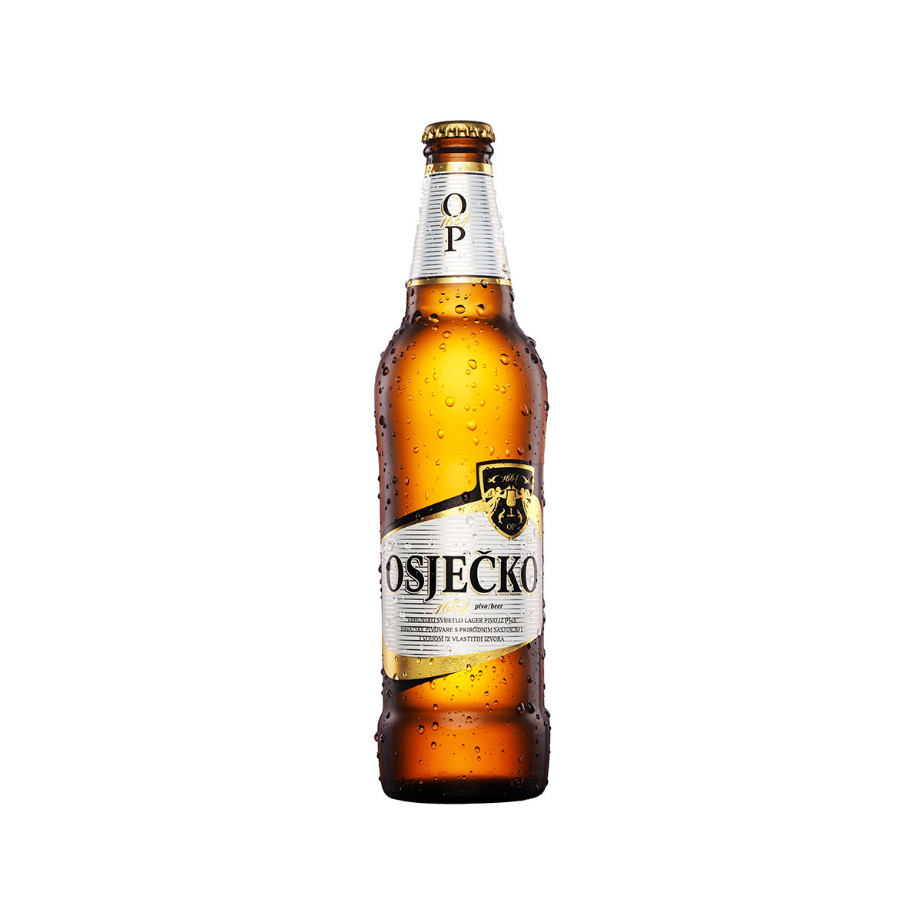
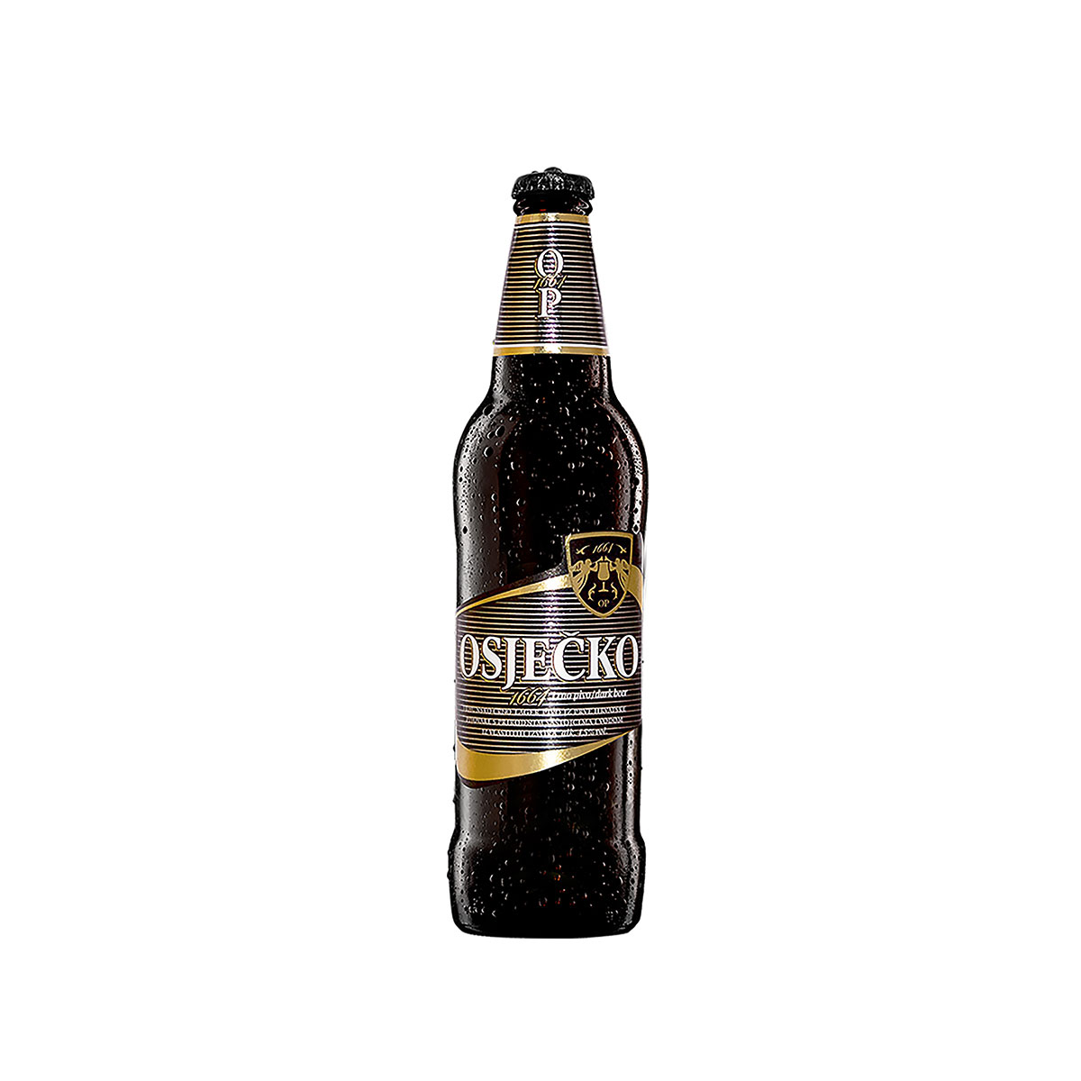
The oldest beer in Croatia
The first breweries appeared in the city of Osijek in the 17th century and the first documented proof of brewing in Osijek is linked to Mr Bauer, who brewed beer in 1664.
And today, we have our amazing Osječko pivo, the first Croatian beer, which is still today made with an original recipe and traditional production method by the Osijek Brewery.

Slide 11
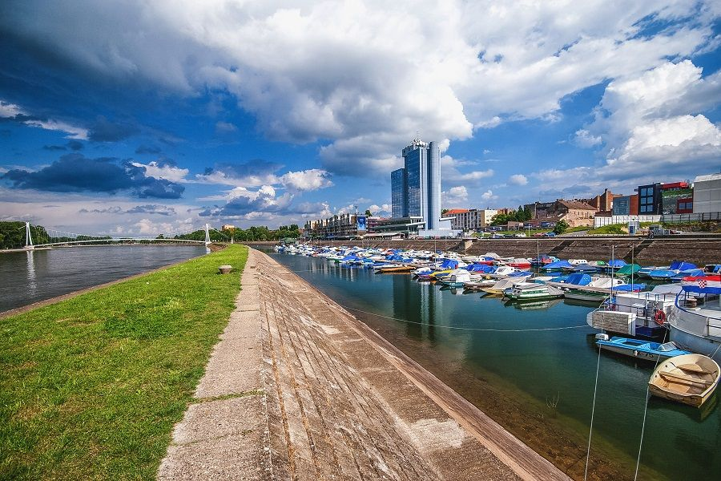
(Almost) longest and one of the most beautiful river promenades
Osijek is situated on the right bank of the Drava river where the city promenade is also located. But, if you want to enjoy a full view of the city, you can also cross one of the bridges and take a walk on the promenade on the left bank.
Osijek’s promenade is currently undergoing further construction to connect the Upper and Lower Towns, and is set to be 12 km long. This will make it the longest river promenade in Europe.

Slide 12
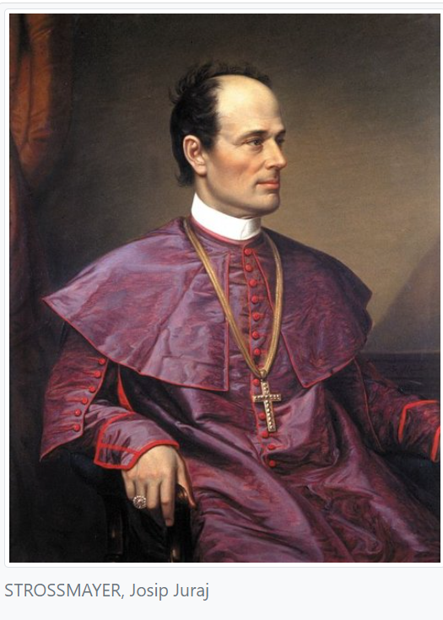
Josip Juraj Strossmayer University of Osijek
Josip Juraj Strossmayer University of Osijek, founded in 1975, is one of the leading universities in Croatia.
We currently host:
14 Faculties, 1 Academy, and 3 Departments offering programs in fields such as Economics, Law, Medicine, Education, Engineering, and more.
16,000 students (undergraduate, graduate, and postgraduate)
2,075 staff members - with 1,415 teachers and associates, and 660 administrative and technical staff.
(Osijek, February 4, 1815 – Đakovo, April 8, 1905) Croatian bishop, theologian, politician, founder of key Croatian scientific and cultural institutions, as well as a writer and patron. He was one of the most significant and influential Croatian figures of the 19th century.

Slide 13
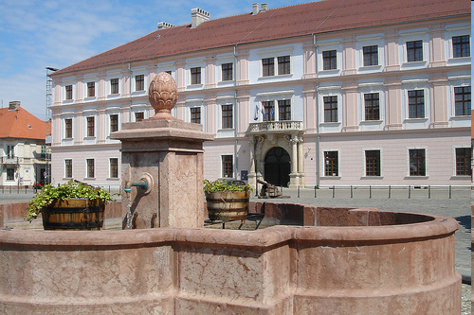
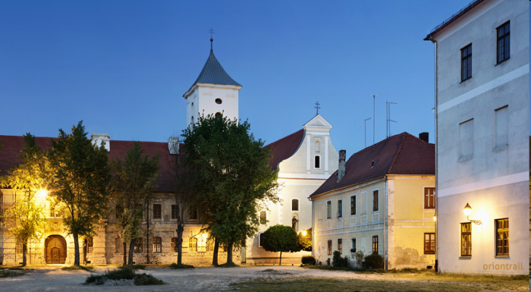
Josip Juraj Strossmayer University of Osijek
Faculty of Agrobiotechnical Sciences
Faculty of Economics
Faculty of Education
Faculty of Electrical Engineering, Computer Science and Information Technology
Faculty of Civil Engineering and Architecture
Faculty for Tourism and Rural Development
Faculty of Food Technology
Faculty of Dental Medicine and Health
Faculty of Medicine
Faculty of Law
Faculty of Humanities and Social
Sciences
Catholic Faculty of Theology
School of Applied Mathematics
Academy of Arts and Culture
Department of Physics
Department of Biology
Department of Chemistry

Slide 14
Let’s crunch some more numbers
INTERNATIONAL COOPERATION AND ERASMUS+ MOBILITY
At Josip Juraj Strossmayer University, international collaboration is at the core of our mission and the university is strongly focused on foster educational and research excellence while embracing the global exchange of knowledge and ideas.
BILATERAL COOPERATION
84 bilateral agreements with institutions from 32 countries on 5 continents
ERASMUS+
1000+ Erasmus+ agreements in 28 Programme countries
35 Erasmus+ agreements with universities in Erasmus+ Partner countries
These partnerships are vital to our success in offering our staff and students enriching experiences abroad, as well as welcoming colleagues and students from all over the world to our campus in Osijek.

Slide 15
COLOURS project
The University of Osijek has become a part of the European university alliance called COLOURS. In a project that will last four years, the University will be cooperating with eight partners:
University of Paderborn (Germany) – project coordinator
Le Mans University (France)
University of Castilla-La Mancha (Spain)
University of Ferrara (Italy)
Kristianstad University (Sweden)
Jan Dlugosz University (Poland)
University St Kliment Ohridski Bitola (North Macedonia)
Ventspils University of Applied Sciences (Latvia)
All the universities in the network are strong regional universities, centers of innovation and research in their regions, joining together with the goal of sustainable and balanced development of European regions and their trifold transformation – green, digital and social.

Slide 16
What about our staff, how much do they go on Erasmus+ mobilities?
UNIOS ERASMUS+ OUTGOING STAFF
At the University of Osijek, Eramus+ mobilities are very popular not only among our students, but also among our staff, both academic and administrative. Every year, we have hundreds of staff applying and visiting universities all over Europe.
Academic year 2022/2023
249 outgoing staff mobilities
Travelled to 24 countries, mostly to: Spain, Slovenia, Serbia, and Hungary
Academic year 2023/2024
282 outgoing staff mobilities
Travelled to 26 countries, mostly to: Spain, Slovenia, Serbia, and Portugal
Academic year 2024/2025
352 outgoing staff mobilities
Travelled to 26 countries, mostly to: Spain, Serbia, Italy, Portugal, and Slovenia

Slide 17
Benefits of Erasmus+ Staff Mobility
Our Agency for Mobility and EU Programmes conducted a research about the impact of Erasmus+ outgoing staff mobilities, and gave us some interesting results. Overall, the conclusion was that participating in Erasmus+ staff mobility offers a wide range of benefits that contribute to both professional and personal growth.
Here are some of them:
Professional development: Staff gain new skills, develop adaptability and resilience, and enhance their academic profiles.
Job satisfaction and well-being: Exposure to new cultures and environments provides inspiration and increases overall job satisfaction.
Networking: Erasmus+ mobilities are excellent opportunities for building international networks, leading to collaborative research projects and academic partnerships.
Innovation: Staff mobility often results in the adoption of new teaching methods and formats, bringing innovation back to the home institution.
Institutional visibility: Increased collaboration raises the visibility of programs taught in English and attracts international students to home institution.

Slide 18
ERASMUS+ INCOMING STAFF IN OSIJEK
At the University of Osijek, we also have plenty of incoming staff from all over Europe, and we organize our own International Staff Week every year.
They say that a picture is worth a thousand words, so instead of talking about it, here are some photos from our staff weeks and incoming staff. ☺
For individual mobilities contact: erasmus@unios.hr

Slide 19
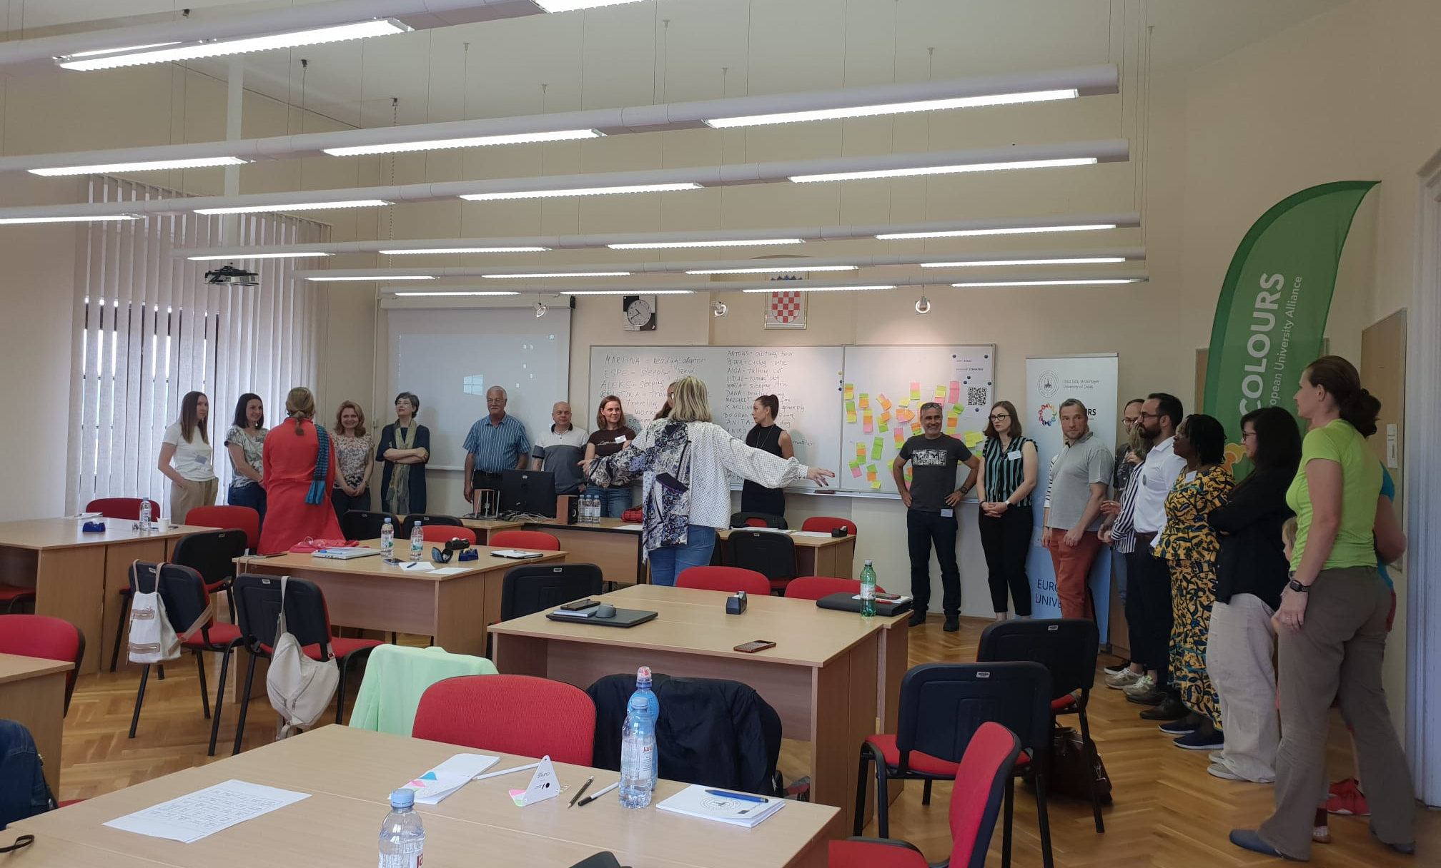
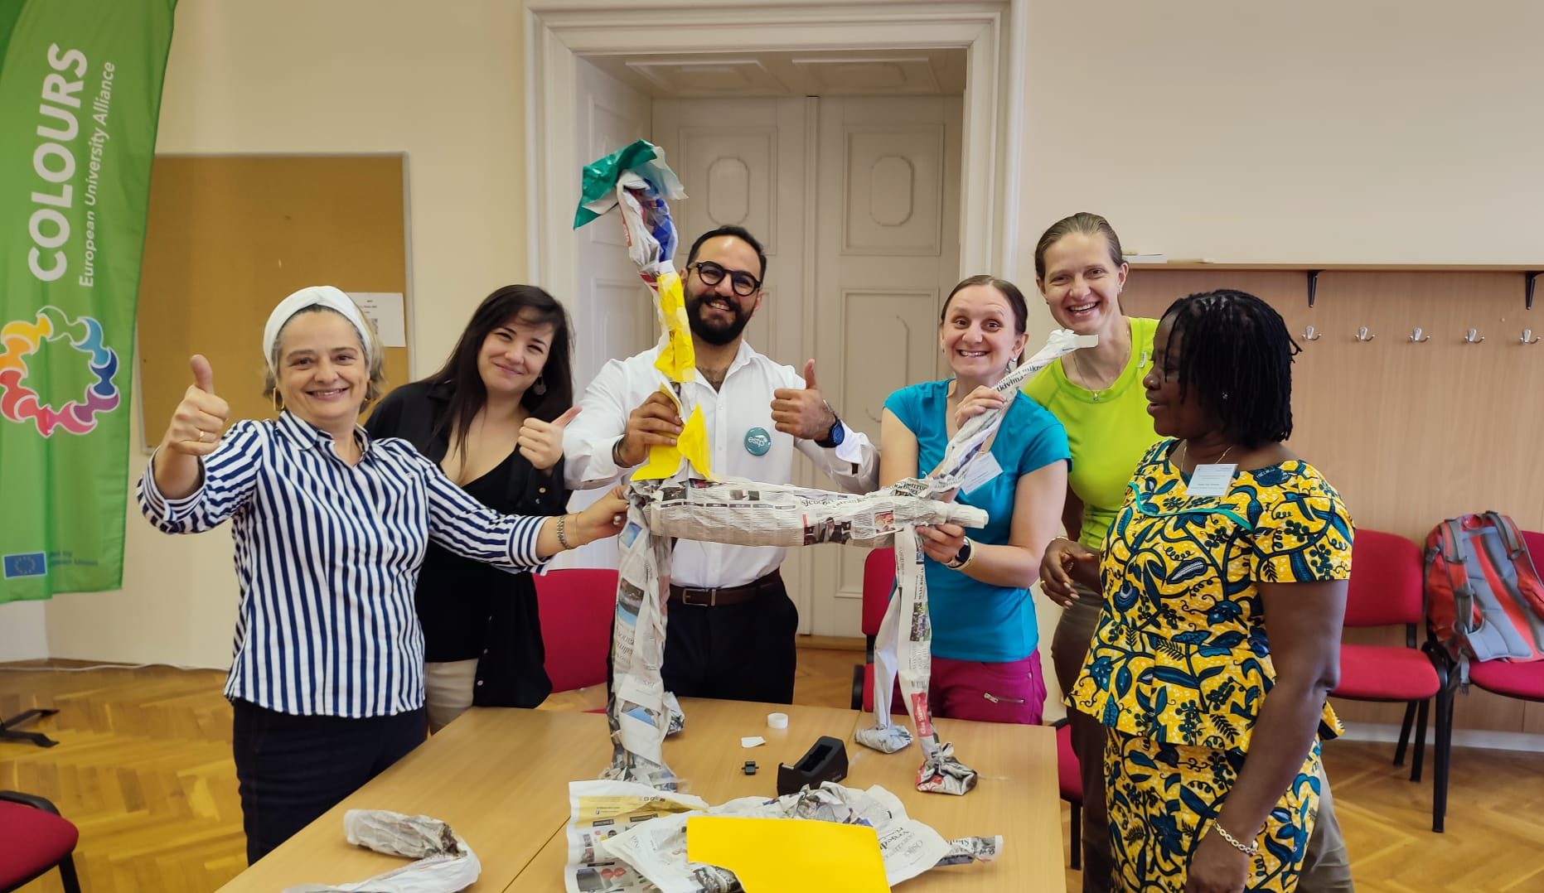
ERASMUS+ INCOMING STAFF IN OSIJEK

Slide 20
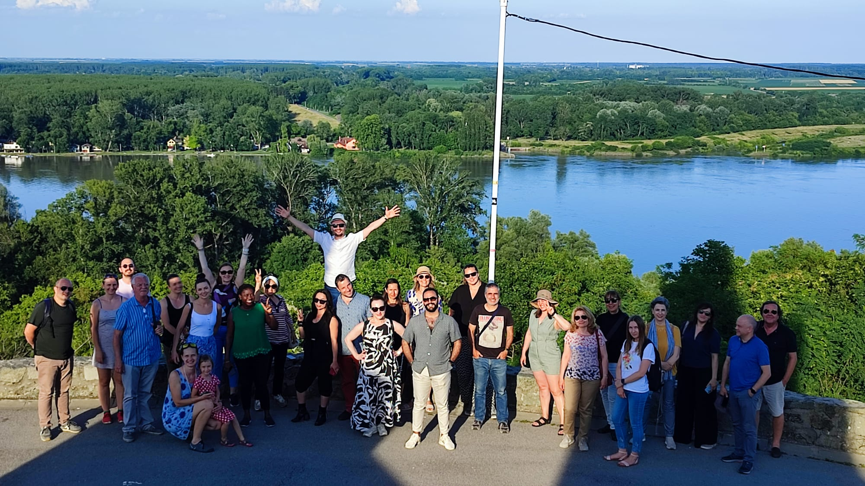
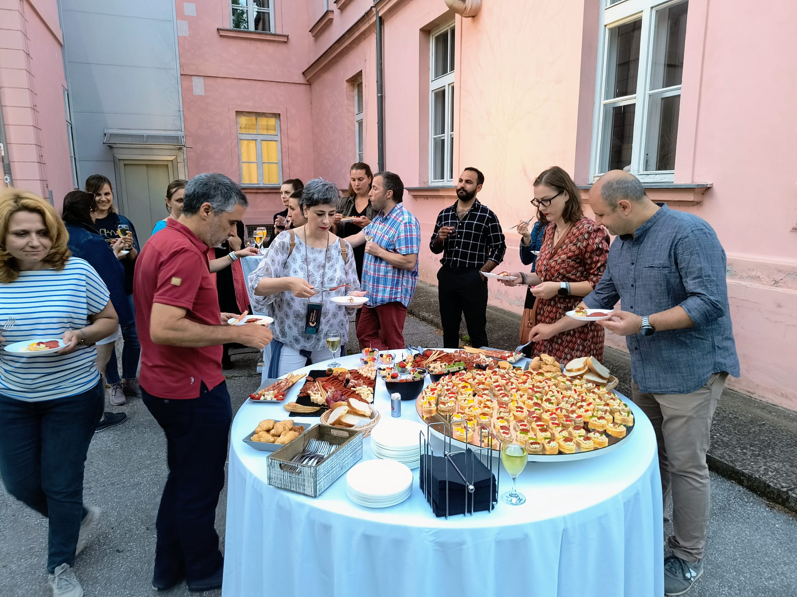
ERASMUS+ INCOMING STAFF IN OSIJEK

Slide 21
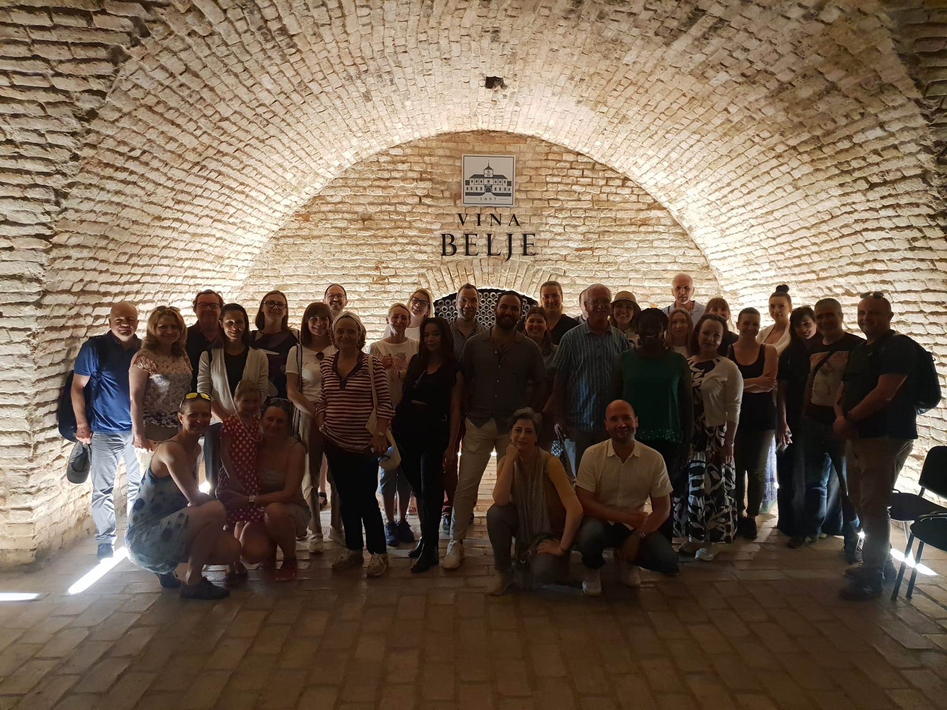
ERASMUS+ INCOMING STAFF IN OSIJEK

Slide 22
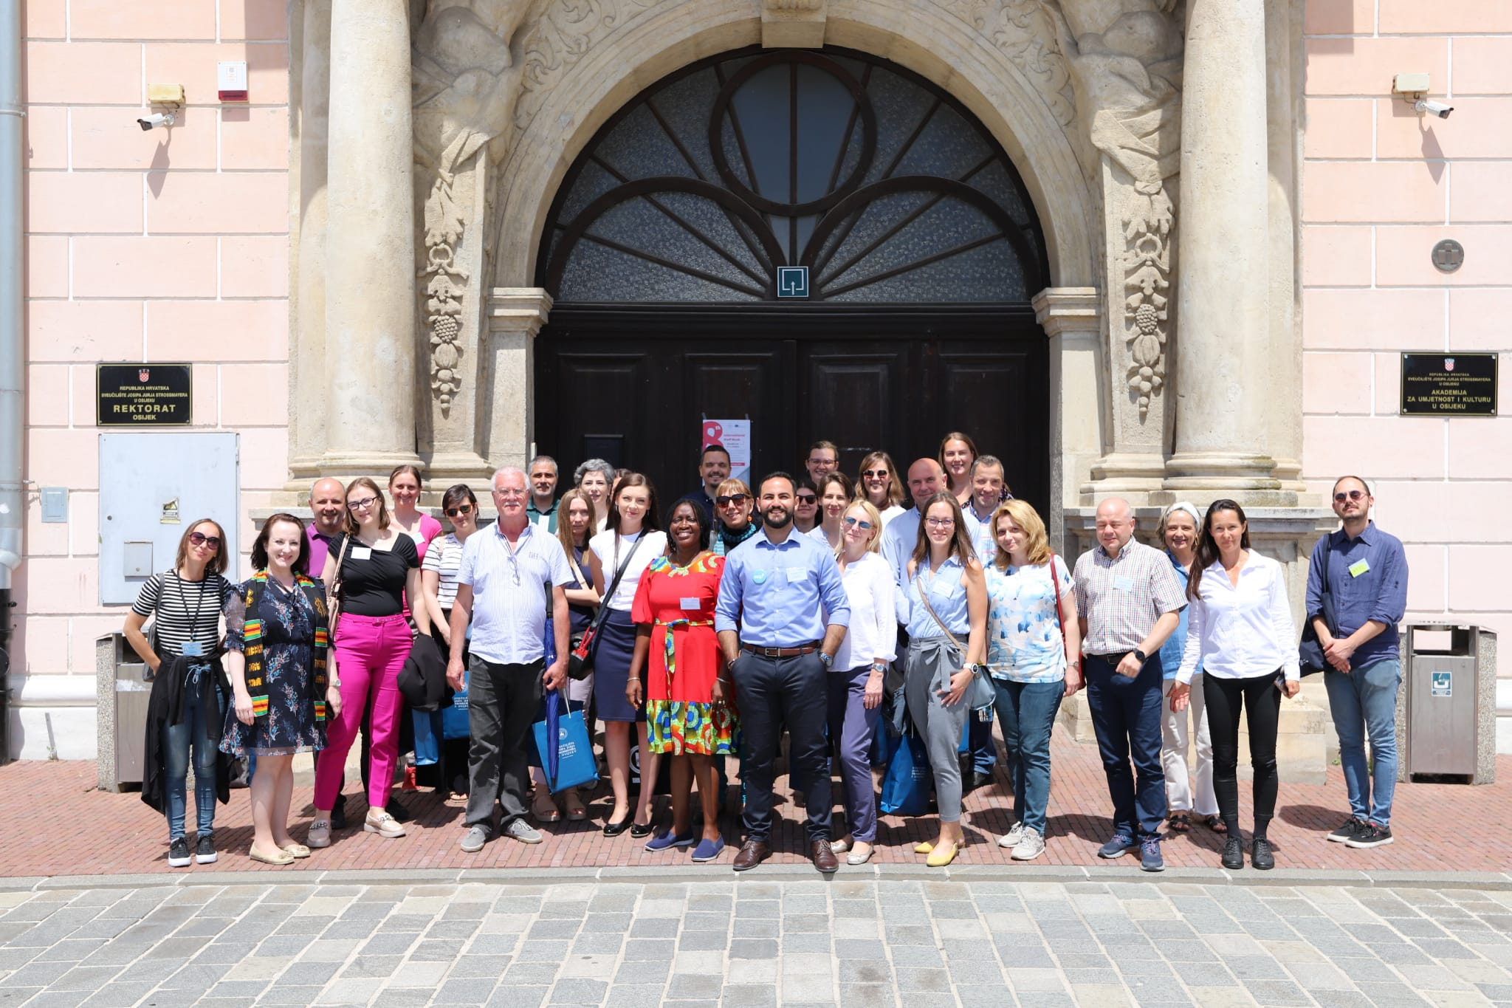
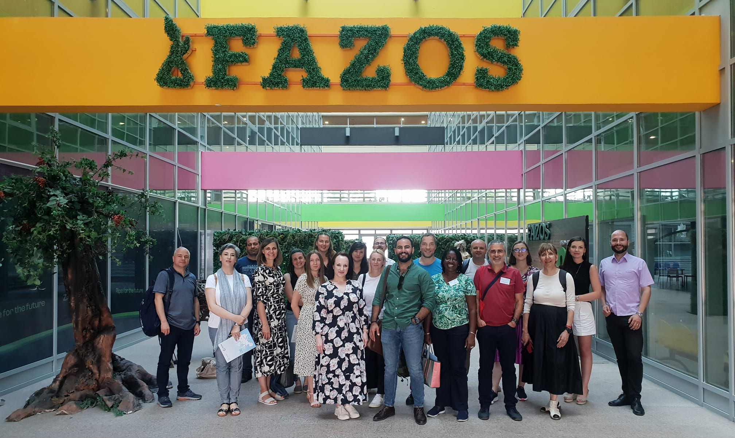
ERASMUS+ INCOMING STAFF IN OSIJEK

Slide 23
THANK YOU FOR YOUR ATTENTION, WE LOOK FORWARD TO HOSTING YOU IN OUR BEAUTIFUL CITY OF OSIJEK!
¡GRACIAS POR SU ATENCIÓN, ESPERAMOS ALOJARLE EN NUESTRA HERMOSA CIUDAD DE OSIJEK!

