Slide 1
JEREZ
CAMPUS CADIZ
ALGECIRAS
CAMPUS
PUERTO REAL

Slide 2
You will find in this powerpoint the application procedures/steps to come to study to the University of Cadiz as an Erasmus student.
Please follow these instructions.
- Recommendation: Please bear in mind this is an interactive powerpoint so please press F5 to view it full screen.
Thanks,
ERASMUS+ KA131 students,
Internationalisation office Universidad de Cádiz.
Attention:

Slide 3
Welcome
Instructions
Contact
Further information
Welcome to UCA
The Internationalisation office of the Universidad de Cadiz would like to welcome all the nominated students for the academic year 2024-25
An international mobility is a great oportunity for the students to enriching both their profesional and academic lives by means of achieving new experiences.
This is the beginning of your stay at the University and Province of Cadiz. We really hope this new period of your life strengthens the visión of a sustainable, inclusive and human vision of the world. Thanks.

Slide 4
Welcome
Instructions
Contact
Further Information
Instructions:
Pre-registration y Registration
The whole process involves the following actors:
Home University: They nominate you as an Erasmus student.
Universidad de Cádiz: Internasionalisation office in charge of administrative matters.
Coordinadores Académicos:
Secretaría Campus:
Academic coordinator: They will help you with academic matters.
Please click Here to start.

Slide 5
Welcome
Instructions
Contact
Further Information
Contact
Opening hours:
From 10:00 to 14:00.
Internationalisation Office:
Address: Plaza de Falla nº 8, Cádiz, 11002
UCA
FactSheet (Here)
UCA Directory (Coordinator): click on Here.

Slide 6
Welcome
Instructions
Contact
Further Information
Further Information
Vice-Rectorate for Internationalisation KA131+: click on Here.
Campuses of the Universidad de Cadiz (See)

Slide 7
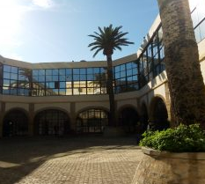
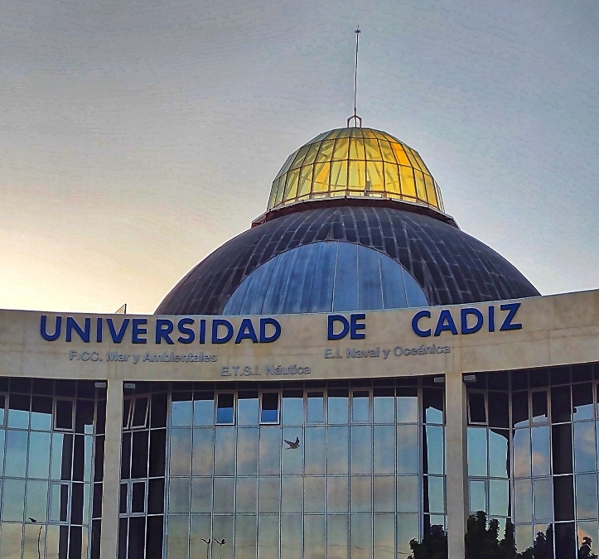
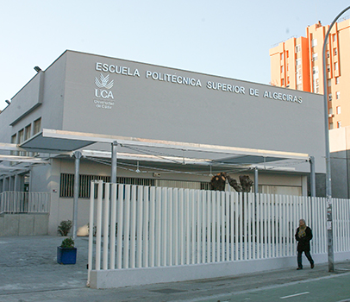
CAMPUS CADIZ
The campuses of the University of Cadiz are located in the provice of Cadiz.
Please click on the Campus you are going to study to know more about your Faculty, academic offer, timetables, etc….
CAMPUS JEREZ
Further Information: (https://www.uca.es/los-campus/)
CAMPUS PUERTO REAL
CAMPUS BAHÍA DE ALGECIRAS

Slide 8
Faculty of Law
(Link)
Fac. of Social and Communication Sciences
(Link)
CAMPUS JEREZ

Slide 9
Faculty of Medicine
Fac. of Laboral Sciences
Faculty of Arts
University Centre for Nursing“Salus Informorum”
Fac. of Business
Faculty of Nursing and Physiotherapy
CAMPUS CADIZ

Slide 10
University School of Naval and Oceanic Engineering
Faculty of Sciences
Faculty of Marine and Environmental Sciences
Faculty of Educational Sciences
University School of Engineering
University School of Marine Nautical and Radioelectronical Engineering
CAMPUS PUERTO
REAL

Slide 11
Escuela Politécnica Superior
(Link)
Faculty of Nursing
(Link)
University School of Education Virgen de Europa
CAMPUS BAHÍA DE ALGECIRAS
(Link)

Slide 12
1. Nomination by Home University
4. Learning Agreement (OLA & NO OLA)
Academic coordinators
2. (Pre)Registration
Universidad de Cádiz
5. Sesiones de registro
Universidad de Cádiz
3. Acceptance Letter
Universidad de Cádiz

Slide 13
1. NOMINATION
Home University
- Deadline:
Autumn Semestre: 25th May.
Spring Semestre: 25th October.
Students in Medicine (any period): 25th May.
Factsheet
- Student details needed:
Home University sends the nomination per email to erasmus.incoming@uca.es with, at least, the following details:.
Name and Surname.
Email address.
Study field.
Period of Stay (1st S. 2nd S. or the whole academic year).
Level of studies (Undergraduate, Master or Docatorate Programme.

Slide 14
- Deadline:
31st May
Universidad de Cádiz
(PRE)REGISTRATION
Please check your inbox e-mail. After your nomination you will receive the following information: (HERE).
- PRE-REGISTRATION
Please follow the information in the document to complete your pre-registration. Once submitted, wait to another e-mail for the…
- REGISTRATION
Follow the second part of the document to complete your registration.

Slide 15
-IMPORTANT:
Your Acceptance Letter will ONLY BE VALID when your Learning Agreement has been signed by you and your coordinators. Please do NOT buy your tickets before that.
Universidad de Cádiz
You will be able to download it when the documentation submitted in the pre(registration) process has been validated but no before 31st May.
ACCEPTANCE LETTER
- How can I download it?
UMOVE: “My placement” > ”Documentation” > ”Documents to download”. Once you see your Acceptance letter you will be able to fill out your Learning Agreement.

Slide 16
- Deadline:
General: 15th July
Faculty of Medicine: 14th June
Coordinador
Académico
- When to fill out your Learning Agreement?
After receiving your ACCEPTANCE LETTER.
Coordinators
How to fill out your Learning Agreement?
Is my home University using OLA or NOT OLA?
Learning Agreement
Home University: Please ask your home University if your Learning Agreement is connected to Erasmus without Paper (EWP).
Click here for the instructions.

Slide 17
ACADEMIC COORDINATORS
You have an academic coordinator in charge of academic matters in your home University and another in the Universidad de Cadiz.
Academic Coordinator in your Home University: He is the one who signs your Learning Agreement and will recognise your studies followed in Cadiz at the end of your stay.
Academic Coordinator at Universidad de Cadiz: He/She will sign your Learning agreement, changes for the learning agreement, etc… and will give you importante academic information such as timetables, etc…
How can I contact my academic coordinator at the Universidad de Cadiz?
Directory
Tutoring Session

Slide 18
LEARNING AGREEMENT
How to fill it out?
Is my Univerity using OLA or NOT OLA?
Home Univeristy:
Is my home Univeristy connected to Erasmus without Paper (EWP)?
Yes : OLA
No : NOT OLA

Slide 19
- INFORMATION FOR ACEPTED STUDENTS.
E-MAIL: Check your e-mail at the end of July. We will be sending two PDF:
SINTESIS
Useful information for our incoming students, such as information sessions, accommodation, Spanish Language Courses, how to arrive in Cadiz province, etc…
PDF ERASMUS AT THE UCA. With instructions on how to registrate your subjects in our computer system in september, how to connect to the WIFI, Services of the University, etc…
REGISTRATION SESSIONS

Slide 20
3
3
4
2
4
2
5
1
5
1

Slide 21
3
3
5
2
5
1
2
4
1
4
Acceptance Letter
Nomination
(Pre)-Registration
Learning Agreement
Registration Sessions
Per e-mail to: erasmus.incoming@uca.es.
Deadline: 25th May
E-mail: Follow the Instructions
Deadline: 31st May
UMove: After the validation of your Documents.
Not before 31st May
OLA
NOT OLA
E-mail with information: End of July.
Students Deadlines:
General 15th July
Medicine 14th June

Slide 22
Edificio Hospital Real
Plaza Falla 8. 11003 Cadiz. Spain.
Internationalisation Office

